Slide 1
VSEPR Theory（价层电子互斥理论） (Valence Shell Electron Pair Repulsion Theory)

Slide 2
Molecular shapes
In an atom, the electrons exist as electron pairs in orbitals. These pairs of electrons repel each other as much as possible.
The shape of a molecule comes from the electron pair repulsion – The VSEPR Model.
The total number of electron pairs determines the shape of the molecule. However, not all electron pairs are the same
Two types of electron dense regions (EDR)s exist:
Lone Pairs
Add to the EDR but are not seen
Bonding Pairs
Create the shape
Note we use the term EDR not electron pair because a double bond is two electron pairs but both point in the same direction therefore it is one direction.

Slide 3
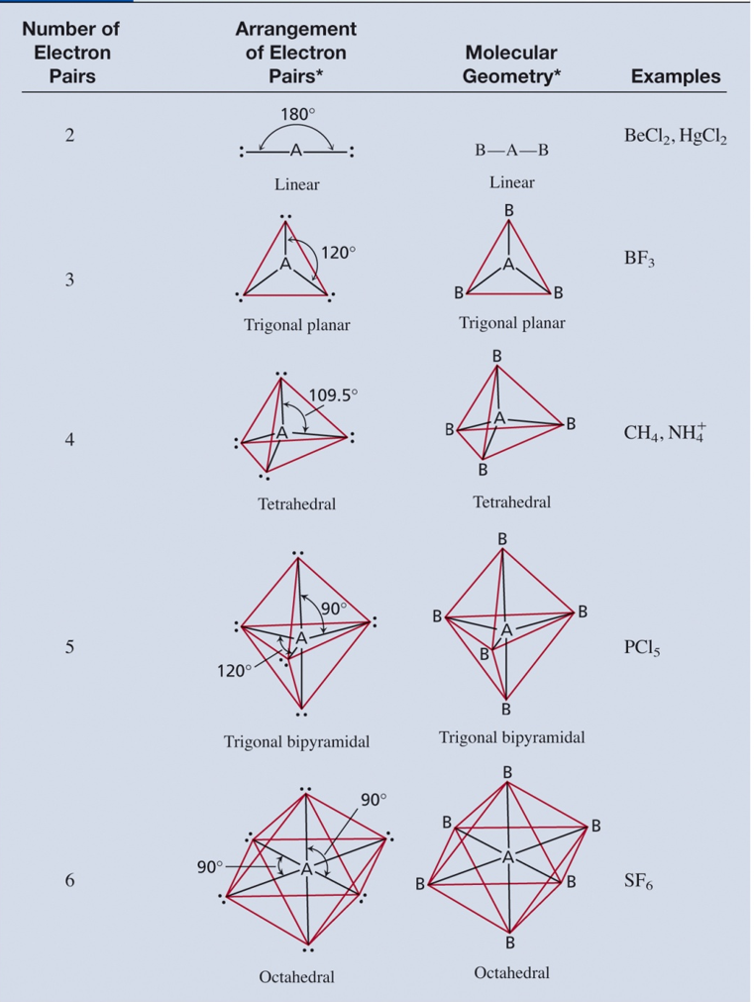

Slide 4
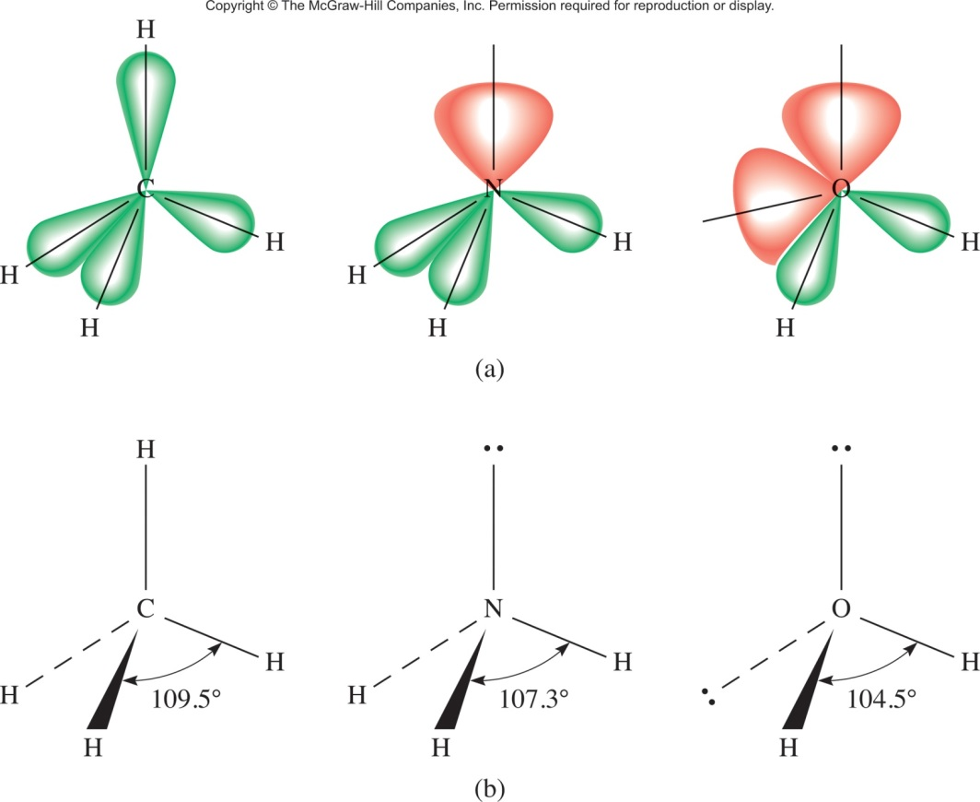
Lone Pair and Bonding Pair
A B C
CH₄ NH₃ H₂O
4 EDR structures
A: 4 bond pairs: Tetrahedral
B: 3 Bond Pair, 1 lone pair: Trigonal Pyramid（三角锥）
C: 2 bond pair, 2 Lone Pair: Bent

Slide 5
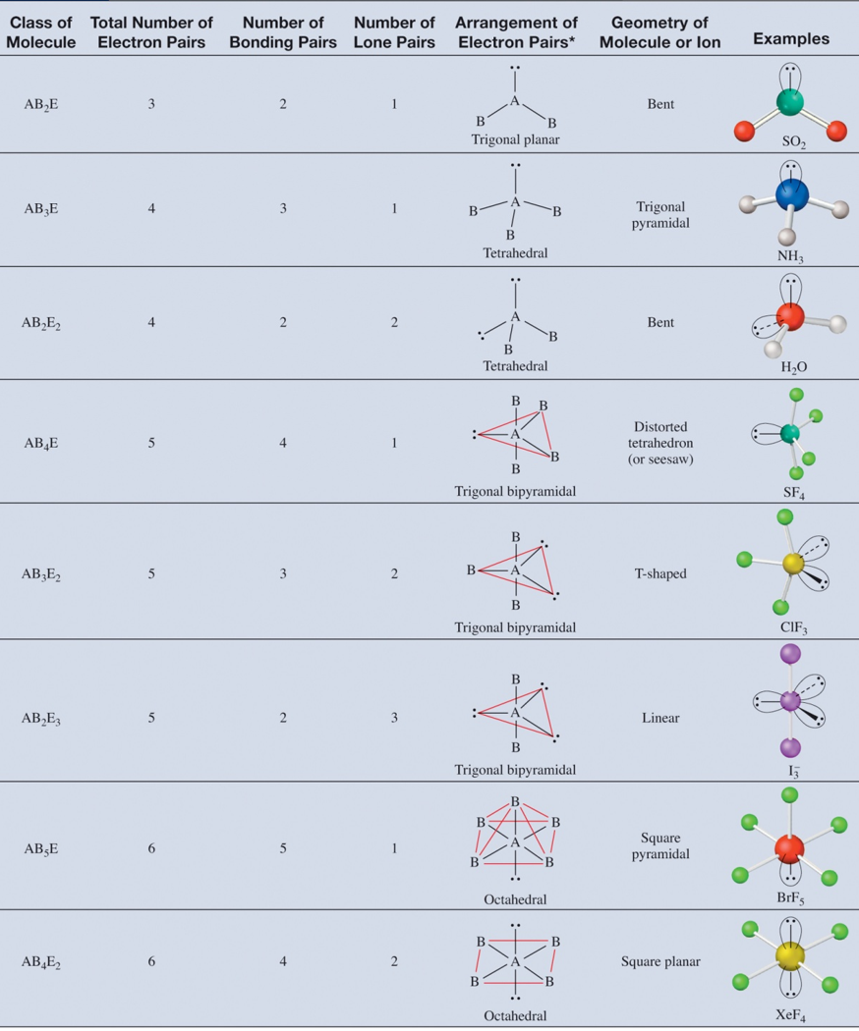

Slide 6
Predicting Molecular Geometry
Draw the Lewis structure for molecule.
Count the number of lone pairs on the central atom and number of atoms bonded to the central atom.
Use VSEPR to predict the geometry of the molecule.

Slide 7

Question
Use the VSEPR model to predict the geometry of the following molecules and ions:
AsH₃
OF₂
C₂H₄
C₂H₂

Slide 8
Polar / Non Polar
Most bonds have a dipole moment. It is due to the difference in electronegativity.
This means the electrons are unequally shared.
However, the shape will determine which bond dipoles result in an overall molecular dipole moment and make the molecule polar.

Slide 9
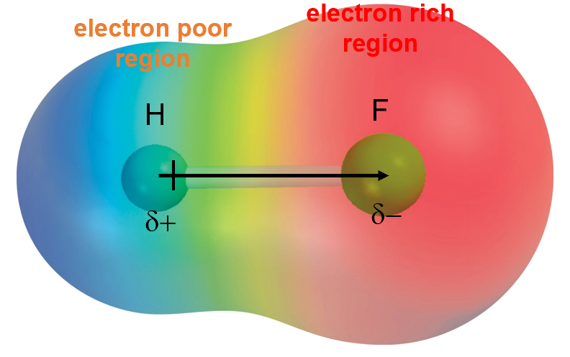
Dipole Moments and Polar Molecules
electron rich
region
electron poor
region
H
F
δ+
δ−

Slide 10
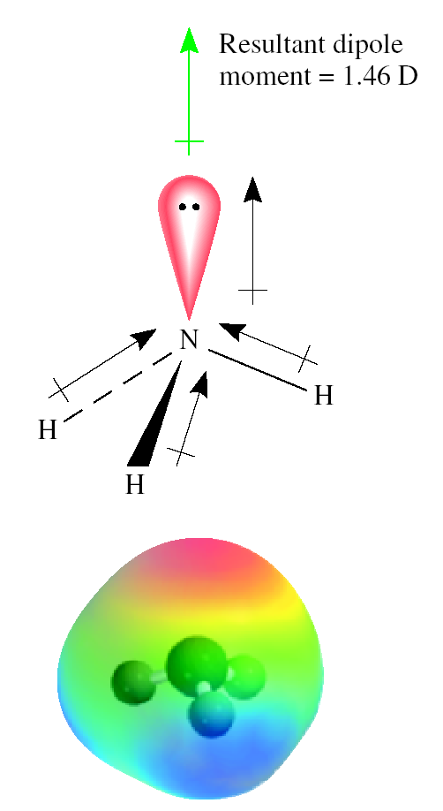
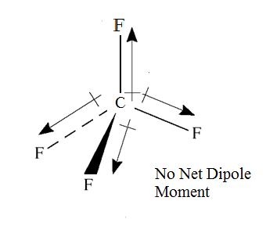
Bond moments and resultant dipole moments in NH₃ and CF₄.

Slide 11
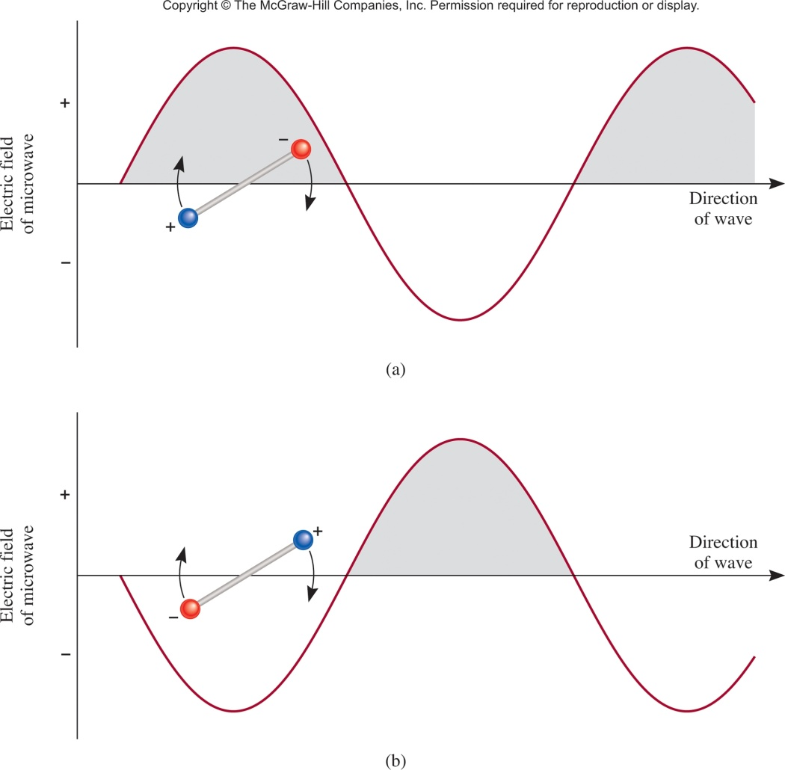
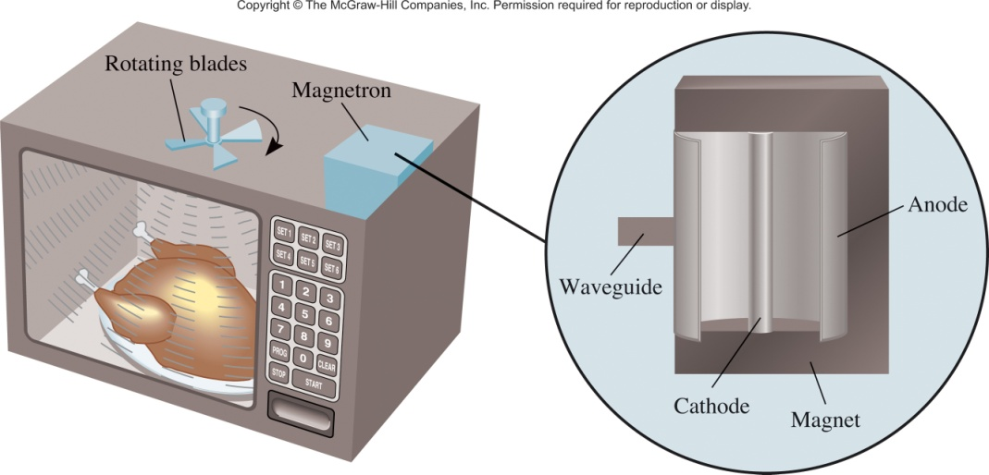
Chemistry In Action: Microwave Ovens
Only works with polar molecules
That is why they heat up the water and not the plastic

Slide 12
Question
Predict whether each of the following molecules has a dipole moment:
BrCl
BF₃ (trigonal planar)
CH₂Cl₂ (tetrahedral)

